Slide 1

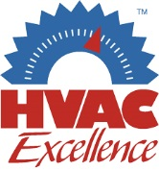

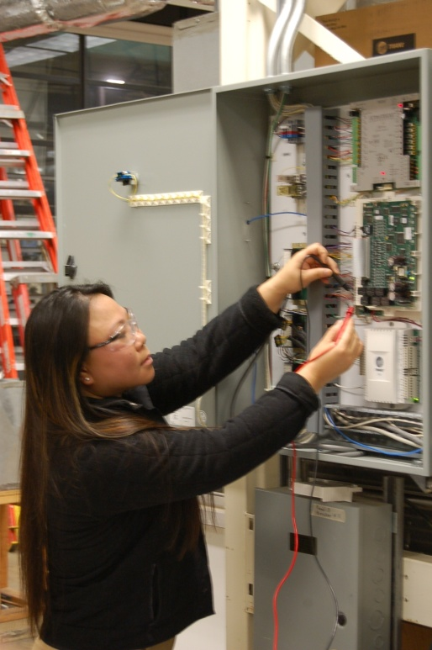

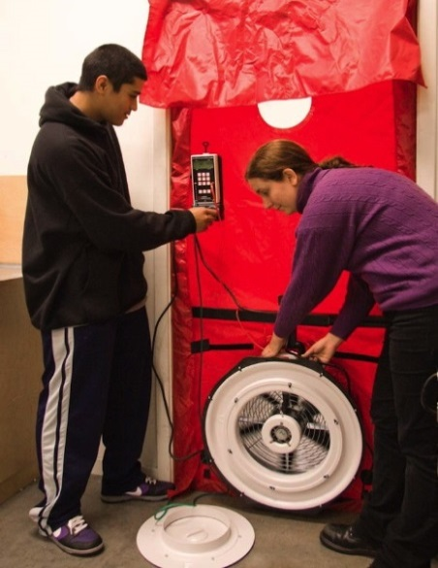
Women in Building Technologies and the Trades
Webinar - April 26, 2018, 10am-11am PST

Slide 2


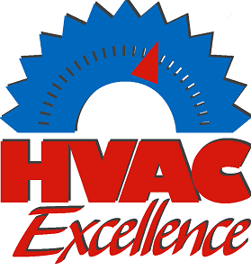
Notes:
On behalf of HVAC Excellence, the BEST Center and our guest presenters, I would like to welcome you to today’s webinar. My name is Renee Tomlinson, representing HVAC Excellence, an industry organization dedicated to improving the HVACR industry through education, validation of skills and professional development. We are proud to partner with the BEST Center, who has a similar mission to promote better building performance through the advancement of building science and technician education.

Slide 3
Today’s Webinar Format
We will end promptly at the hour.
All attendees will be muted.
You may submit questions by using the question tool; if there is time at the end of the session we will answer as many questions as possible.
This webinar will be recorded; the recording will be posted to the BEST Center website: www.bestctr.org
Notes:
Before we get started, we want to inform you of our webinar format.
We want to be respectful of everyone’s time, so we will end our presentation on the hour.
All attendees will be muted throughout the presentation. You may submit questions through the question tool on your control panel or by sending a message through the chat feature.
If time allows, we will answer as many questions as possible at the end of the presentation. If we are unable to get to your question, we will follow up with you by email.
This webinar will be recorded and the recording will be made available on the BEST Center website.

Slide 4
Presentation agenda
Welcome
Reneè Tomlinson – HVAC Excellence
Introduction and Overview of BEST Center
Pamela Wallace – BEST Center Director
Attracting Women and Gen Z to the Building Trades
Merry Beth Hall, Vice President, Education Content for the PHCC Educational Foundation
A Technician’s Perspective
  Telese Williams, Skilled Trades Technician, Georgia State University
Recruiting Women into Technical Programs
  Dr. Deb Hall, Program Chair, Energy Management & Controls Technology, Valencia College
A Student’s Story
  Samantha Lott, Mechanical Electrical Technology Student, Sacramento City College, CA
Q&A – facilitated by Larry Chang, BEST Center Manager

Slide 5

BEST Center - National Science Foundation
National Center for Building Technician Education
Laney College, Oakland, CA; www.bestctr.org
Mission: To prepare technicians to manage building systems and energy use by
Spurring a national forum on the role of building technicians in energy efficiency
Advocating for advanced technical education & high- performance building operations
Facilitating the dissemination and adoption of exceptional curricula and technical programs in sustainable building performance
Goals
Expand the capacity of community colleges to provide building systems technician education, e.g. Heating, Ventilation & Air Conditioning, Building Automation Systems.
Engage industry stakeholders in a national collaboration with community colleges.
Strengthen the STEM pathway for building science professionals and technicians to include high school STEM education and career awareness.

Slide 6
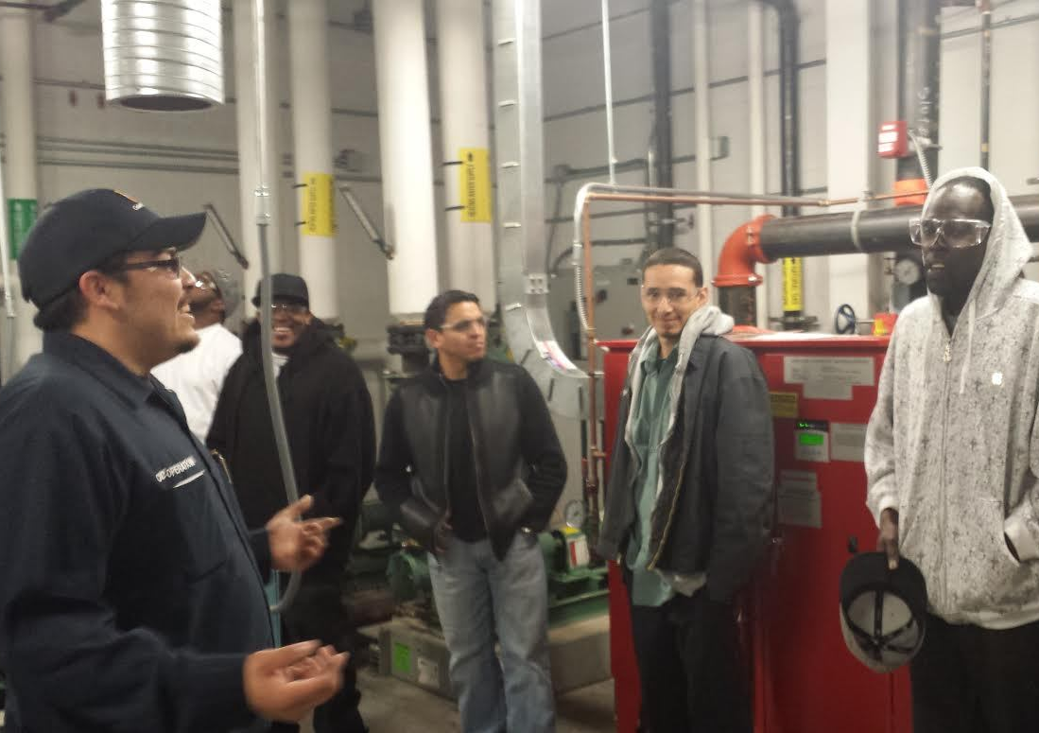
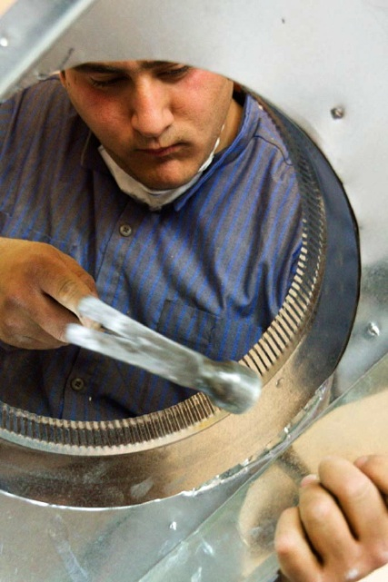
What are some occupations for building technicians?
  BEST Center Career Videos:
  Building a Better Tomorrow Now (2.5 min) - https://www.youtube.com/watch?v=zLXPWb45_IY
  Building a Better Tomorrow (7 min) - https://www.youtube.com/watch?v=Ohti1aHHK7g&t=5s
Building Automation/ Controls Technician
Building/Stationary Engineer
HVAC Installation/ Service Technician

Slide 7
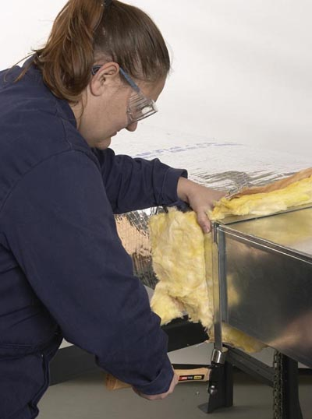
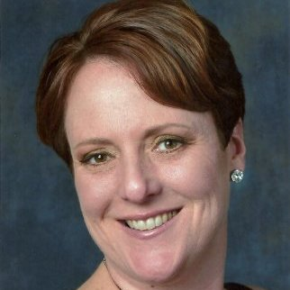
Attracting Women and Gen Z to the Building Trades
Merry Beth Hall,
Vice President,
Education Content for
the PHCC Educational Foundation

Slide 8
What Does Our Workforce
Look Like?
Trade | Women | White | Black | Asian | Latino
HVAC | 2.0% | 74.3% | 5.4% | 2.4% | 17.9%
Plumbing | 2.2% | 62.4% | 9.0% | 1.5% | 27.1%
Electrical | 2.5% | 71.7% | 6.7% | 2.5% | 19.1%
% of Total Population | 50.8% | 61.3% | 13.3% | 5.7% | 17.8%
Pattern of Underrepresentation
Is it Better for Plumbers?
Of the 600,000 plumbing jobs in the United States, 13,200 are held by women.
Women and minorities (other than Latino) are underrepresented in the construction trades.
Where are the Bright Spots?
Less than 10,000 Women in HVAC
Women are most heavily represented as construction managers (7.4% of workforce), helpers (9.4%), and inspectors (10.2%).
Of the 448,000 HVAC jobs in the United States, less than 10,000 are held by women.
Source: U.S. Department of Labor, Bureau of Labor Statistics. 2017. “Table 11. Employed person by detailed occupation, sex, race, and Hispanic or Latino ethnicity, 2017”. Current Population Survey, Household Data Annual Averages, https://www.bls.gov/cps/cpsaat11.htm (accessed March 9, 2018).

Slide 9
We Know Who Women Are,
But Who Are Gen Z?
Post-millennial generation
Born since 1995
Make up almost 1/3 of the U.S. population
Strengths:
Technology
Collaboration/teamwork
Flexibility
Value stability and a consistent paycheck
Value training and development
Weaknesses:
Interpersonal skills
Shortfall in highly cognitive social skills
  Problem solving
  Critical thinking
  Communication

Slide 10

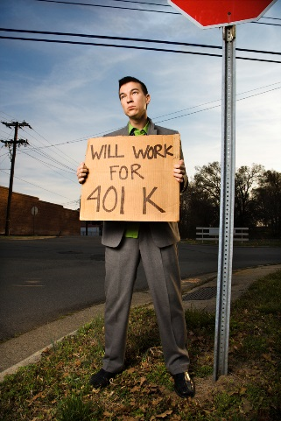

What Does Gen Z Want?
To Be Valued
To Work for Busineses that Give Back
To Know
Gen Z wants to know the employer cares about their success.
Gen Z wants to work for businesses that give back to the community.
Gen Z wants to know every job perk they can expect to see ahead of time – no matter how big or small. Talk about growth opportunities too!

Slide 11

AS THE SAYING GOES…
“Insanity: doing the same thing over and over and expecting the different results.” – Unknown
Yet we continue to recruit for our industry using the same tactics.
And it still doesn’t work.

Slide 12
How Do We Stop the Insanity?
1
Offer paid internships.
2
Capitalize on their strengths.
3
Promote what they care about.
Gen Z doesn’t know what “helper” means. The term is outdated.
Emphasize the ability to collaborate on projects in job ads.
They don’t care about your past. They care about your NOW.
4
Benefits are king.
5
Show them the career path.
6
Know you will have to train.
Tell them about every single job “perk”, no matter how small.
Tell them about where they can go from here. They are concerned about the future!
Understand that you will have to train for those highly cognitive social skills. And do it.

Slide 13
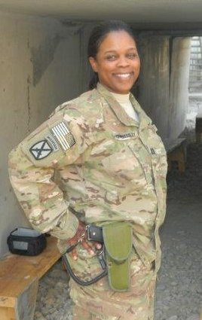
Diversifying the Applicant Pool
MIDDLE & HIGH SCHOOL STUDENTS
Traditional audience.
Still important to reach with our message.
VETERANS
Reach out to transition office at local military base.
Ideal candidates for our industry – many comfortable working with hands/tools.
COMMUNITY COLLEGE GRADUATES
Many students underemployed after completing degrees, but do not want to pursue four-year degree.

Slide 14
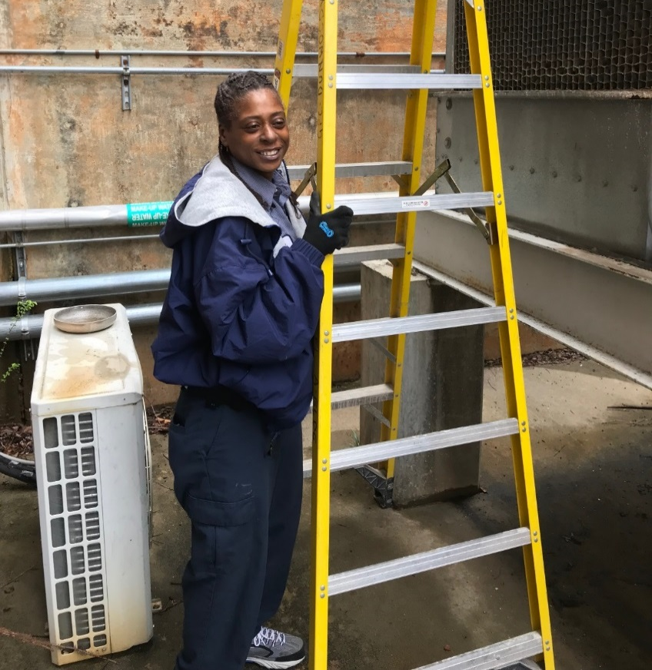
A Technician’s Perspective
Telese Williams
Skilled Trades Technician (Facilities) Georgia State University, Clarkston, GA
New Choices for Women (training for non-traditional jobs) in Atlanta, completed program in 1997.
Started as a brick mason, joined construction company, tired of long hours and layoffs!
Became Maintenance Technician at GA State University in 2005; responsible for electrical, plumbing, carpentry, HVAC repair and operations.

Slide 15
A Technician’s Perspective
Promoted to Skilled Trades Technician.
Earned multiple industry certifications; Building Operator Certification, Level 1 (nationally-recognized credential) led to promotion.
Mentors and family support are key.
“I wish more women would consider such a career path because at the end of the day you feel good as a woman that you made a difference during your day. It’s not easy, but it’s well worth choosing this career path.”

Slide 16


Recruitment of Women for Technical Programs
What a TRULY Bright Idea!
Presented by Dr. Deb Hall
Program Chair and Professor
Energy Management and Controls Technology
Electronics Engineering Technology
Valencia College Division of Engineering, Computer Programming, and Technology

Slide 17
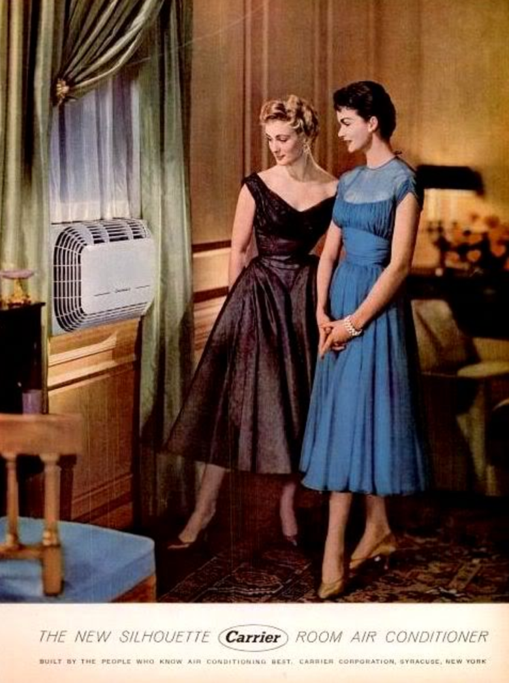

Let’s redesign the control system to improve the overall energy efficiency…

Slide 18
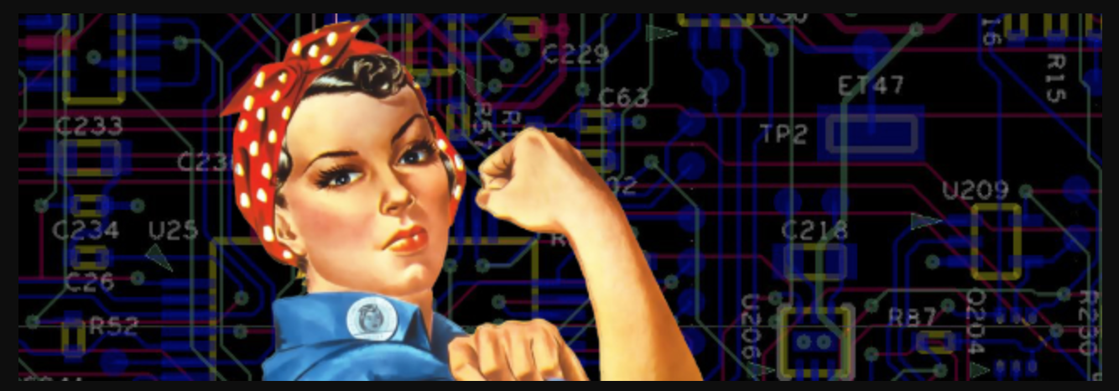
What Women Bring into the Technical Industry…
Better work environment for solving disputes
Improvements in productivity and innovation
Stronger team dynamics that are more united and ready for optimal decision-making…
Diversity is
to effective
organizations of the future!!!
KEY

Slide 19

Create a Women in Technology program and appoint a full time program director…
Some institutions who have implemented this best practice:
Purdue University, Kansas State University, University of Maryland, Southern Methodist University, Rochester Institute of Technology, New Jersey Institute of Technology, University of Texas at Austin, and Iowa State University
RECOMMENDATION

Slide 20

Hire additional female technology faculty members…
They will be a great source of inspiration and mentoring for your female technology students!
RECOMMENDATION

Slide 21

Create a Women in Technology Program Advisory Board
Comprised of local area female technicians and invite these females to be guest speakers within your courses…
RECOMMENDATION

Slide 22

Encourage your College to Form a Partnership with Local Female Professional Networking Organizations
Such as:
Women in ASHRAE
https://www.ashrae.org/conferences/winter-conference/2019-ashrae-winter-conference-social-events#wia
Women in HVACR
https://www.womeninhvacr.org/
Society of Women Engineers (SWE)
http://societyofwomenengineers.swe.org/
Women in Energy
https://wewomeninenergy.com/
…or other similar female professional networking organizations
RECOMMENDATION

Slide 23
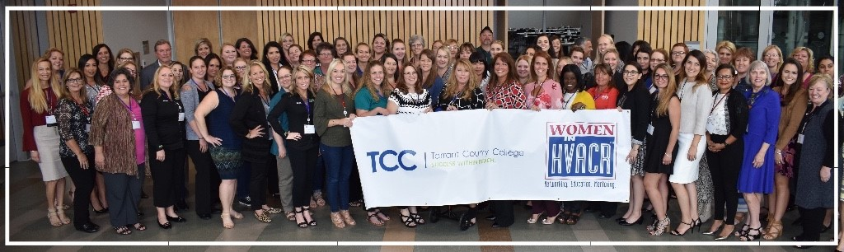
Encourage Faculty Members to Attend Women in Technology Related Events
Such as the Women in HVACR or SWE Conferences or the Women in ASHRAE Meetings at ASHRAE Conferences and the AHR Expo…
RECOMMENDATION

Slide 24
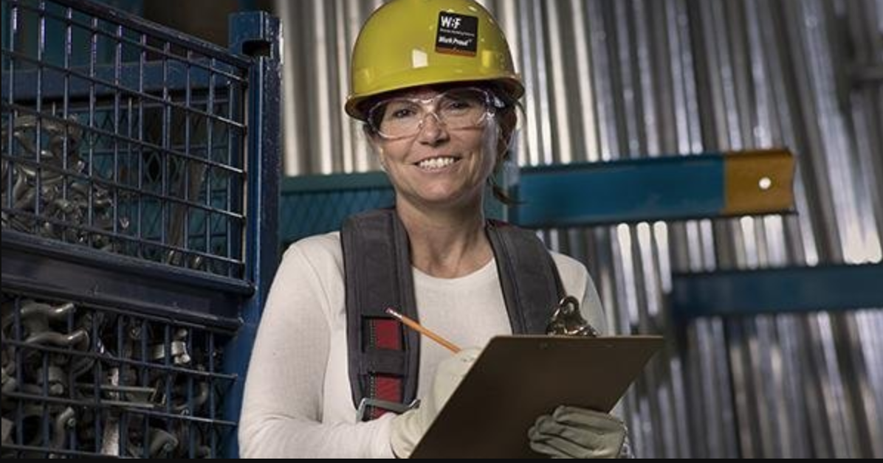

Create a Student Club Related to a Female Professional Networking Organization
Such as a student branch of:
Women in ASHRAE
Women in HVACR
SWE
Women in Energy
or a similar female professional networking organization…
RECOMMENDATION

Slide 25

Form a Partnership Between the College and Online Mentoring Programs
Such as MentorNet to provide students with free protégé experiences…
RECOMMENDATION

Slide 26

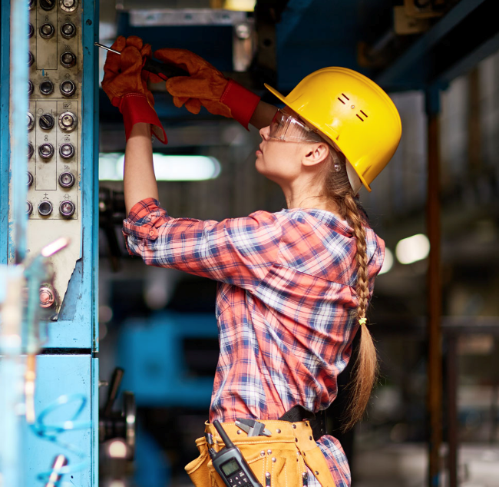
Implement a Peer Coaching Program
Where every first year female technology student is assigned to two second year female technology students to network and support each other…
RECOMMENDATION

Slide 27
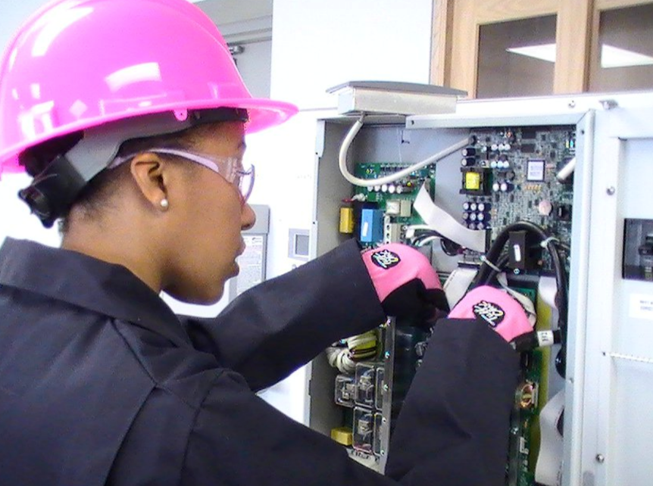
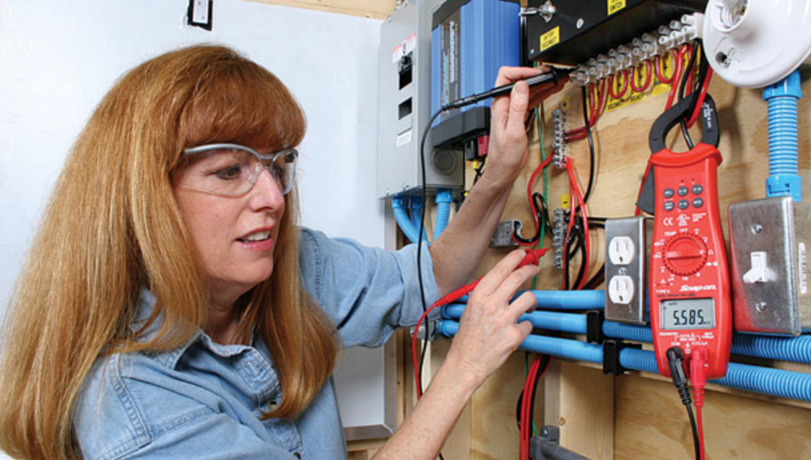
Weave throughout your introductory courses various “Student Success” related topics
Such as time management, team work, communication, organization, effective study strategies, and how to find and use one’s natural strengths…
RECOMMENDATION

Slide 28
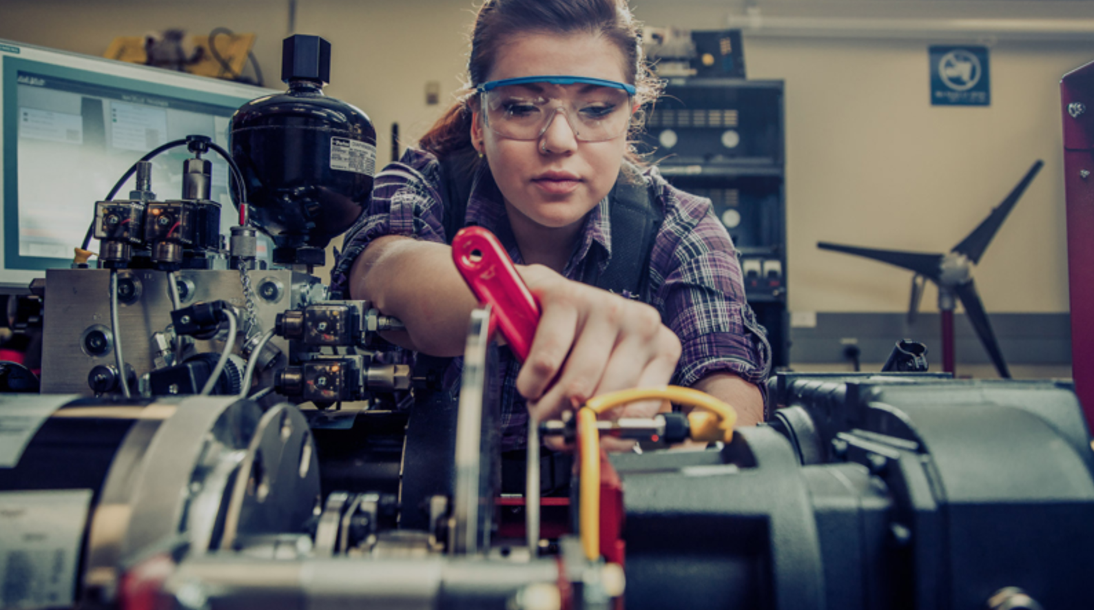
Offer more sections of the same technology courses
On line, at night, and on different campuses of the college…
RECOMMENDATION

Slide 29
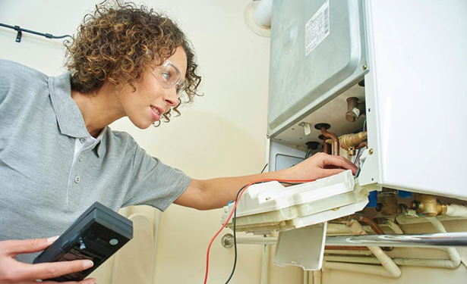
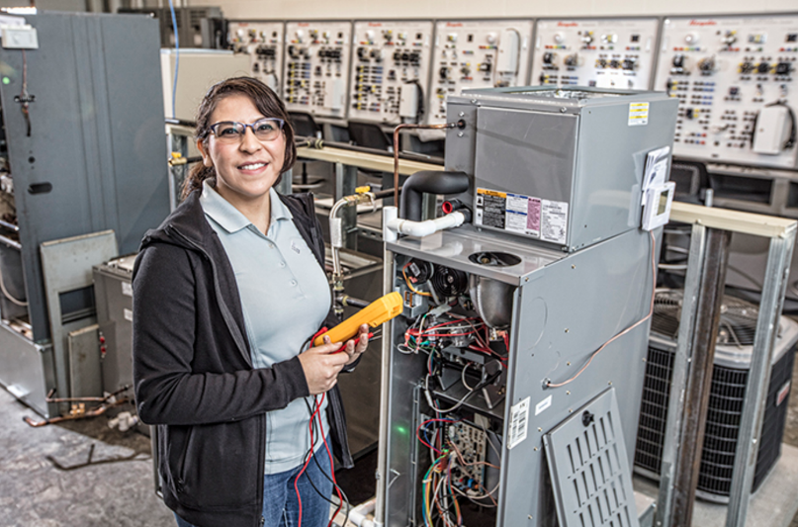
Modify your Department’s
Web Page to Promote
Women in Technology
Provide female students with a variety of resources such as networking opportunities, internships, scholarship opportunities related to tuition or certification exam costs, and tutoring sessions…
RECOMMENDATION

Slide 30
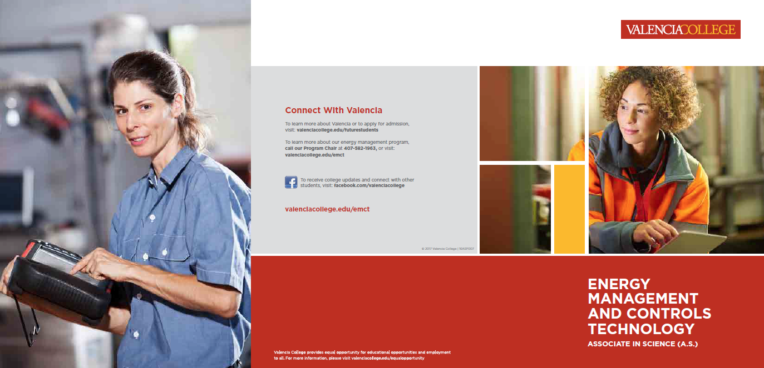
Include Images of Female Technicians and Technology Students on Your College’s Marketing Related Materials
Such as program brochures, banners, tri-folds, posters, and program web page…
A picture truly is worth a thousand words!
RECOMMENDATION

Slide 31
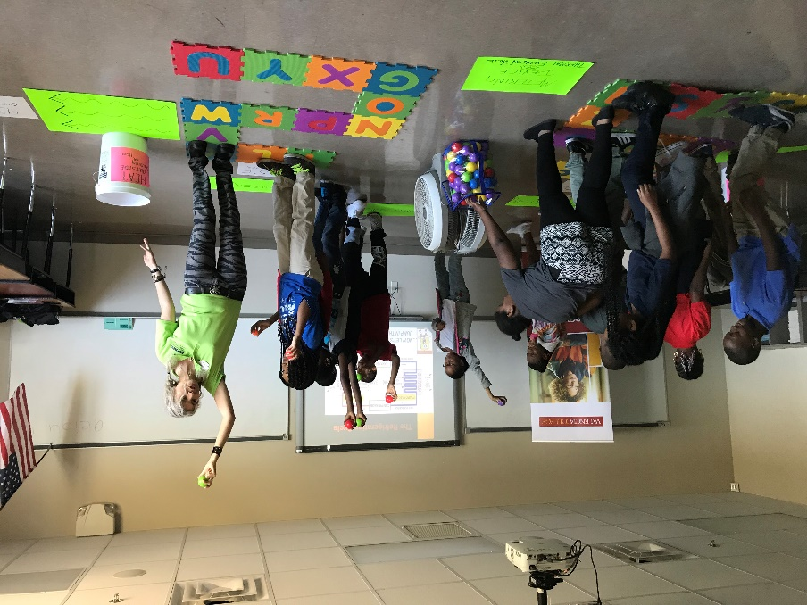
Participate Annually in Various K-12 Outreach Programs
Such as a “Teach-In”, a Boys and Girls Club hands on workshop, National Engineers Week’s “Introduce a Girl to Engineering Day”, Expanding Your Horizons program, The Girl Scout Engineering Saturday program, SWE’s Discover! Program, or a Parent / 5th Grade Daughter TEA (Technology Engineering Aptitude) Workshop…
RECOMMENDATION
Refrigeration Cycle Hands On
5th Grader Outreach Activity

Slide 32
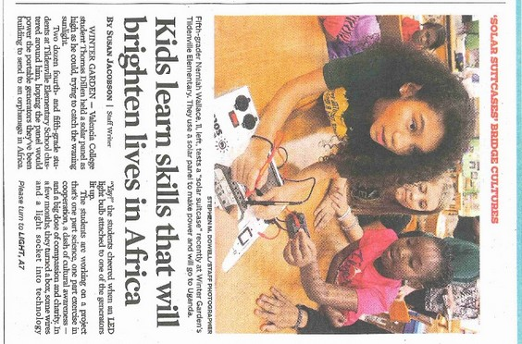
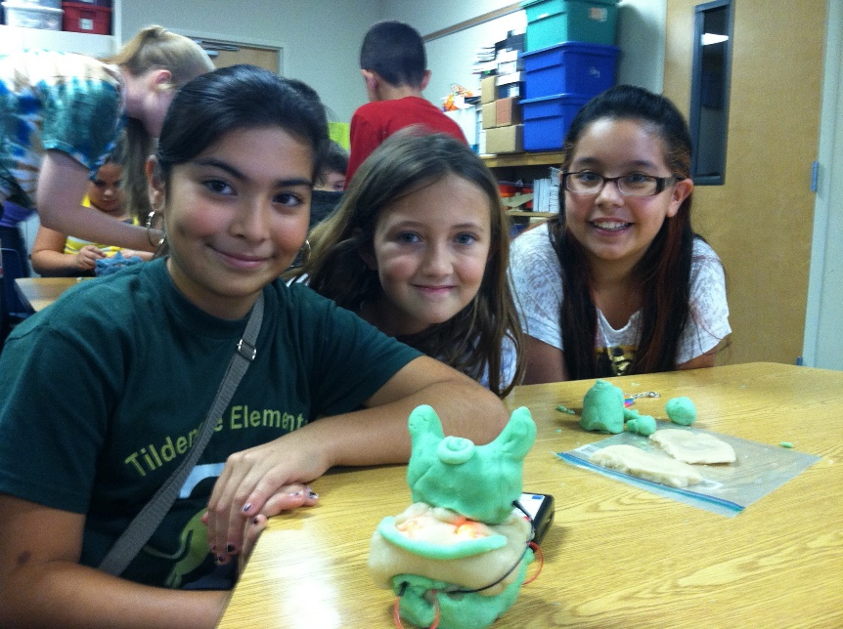
Hold Technology Related Summer Camps
For 5th grade through high school female students that include hands-on STEAM related activities…
RECOMMENDATION

Slide 33


Concepts to Emphasize When Doing K-12 Outreach
You'll have the POWER to make a
difference!
You'll be working with other talented people!
Technology is a team effort…
You'll have money and job security!
Society will always need technicians…
You'll have lots of options as
technicians work EVERYWHERE!
You'll get to do stuff!
  Be the FIRST to try out a new technology!!!
Technicians are involved in making
ALL the wonders of the future a REALITY today!
cool

Slide 34


Global Initiative to Raise Awareness of Opportunities for Women in the HVAC/R Related Industry
OzonAction and UN Women are seeking short ‘stories’ about women working in the refrigeration and air-conditioning (RAC) sector in regards to their motivations, training and education, challenges, experiences, day to day details of their working lives, and successes.
All accepted submissions will be compiled into an official publication and outreached to a broad range of stakeholders in the Montreal Protocol and RAC community.
Two of the authors will be invited to attend an awards ceremony and side event organized by UN Environment OzonAction at an international Montreal Protocol meeting.
Completed entry forms with descriptions and photos should be received by July 31st, 2018.
Further information can be found on the website below:
http://web.unep.org/ozonaction/news/ozonaction-launches-initiative-highlight-women-refrigeration-and-air-conditioning-sector
Feel free to pass along this neat opportunity!

Slide 35
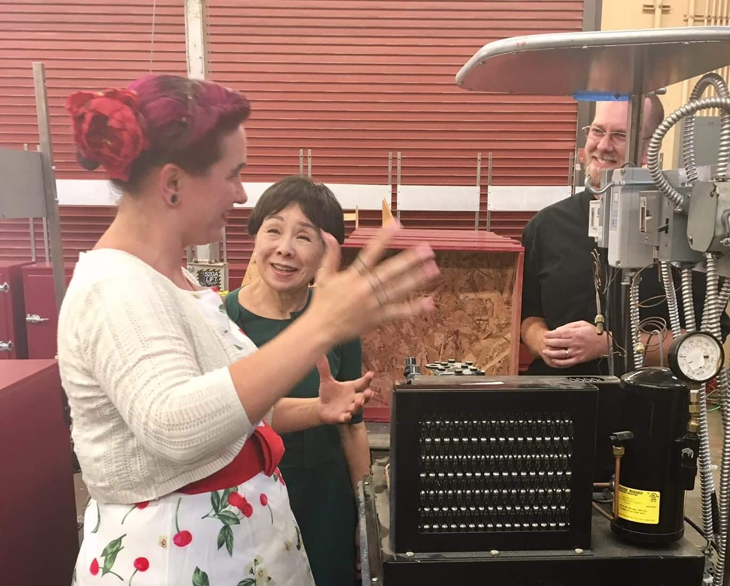
A Student’s Story
  Samantha Lott
  Mechanical Electrical Technology Student, Sacramento City College, CA
Grandpa was her hero, who said, “It doesn’t matter that you’re a girl. Never depend on anyone--learn to do it yourself.”
Went to school to try different things and worked various jobs. As a single mom raising three children, she sometimes felt a bit lost, but never gave up.

Slide 36
A Student’s Story
Stepdad was a stationary engineer for over 20 years, and he encouraged her to enroll in the MET program.
Currently in 3rd-semester, pursuing the Associate of Science degree.
“I enjoy my education and for the first time I feel like I belong. The professors have helped me with more than just my education. They have mentored and guided me in both personal and professional aspects and have become like a family for me.”

Slide 37
Q&A/ Contact Us
Pamela Wallace, BEST Center
pwallace@peralta.edu
Merry Beth Hall, PHCC Foundation hall@naphcc.org
Telese Williams, GA State University
telese1@bellsouth.net
Dr. Deb Hall, Valencia College
dhall@valenciacollege.edu
Samantha Lott, Sacramento City College
samananthap@gmail.com
HVAC Excellence - ESCO Group
www.escogroup.org/hvac/
Renee Tomlinson – Director, Strategic Partnerships
renee@escogroup.org
800-726-9696
BEST Center
www.bestctr.org
Larry Chang, Manager
510-464-3240

